Slide 1

POTO COIN
[PTC]
WHITEPAPER

Slide 2

INTRODUCTION
Poto Coin (PTC) is a community-driven BEP-20 token created on the Binance Smart Chain (BSC). Designed with simplicity, transparency, and community growth in mind, PTC aims to establish a strong presence within the decentralized ecosystem, leveraging the power of decentralized exchanges like PancakeSwap.
MISSION STATEMENT
Our mission is to empower a global community of holders united by shared values of transparency, fairness, and decentralized participation. Poto Coin seeks to create lasting engagement and recognition as a trusted community token on the Binance Smart Chain.

Slide 3

TOKEN DETAILS
Token Name: Poto Coin
Blockchain:
Binance Smart Chain (BSC)
Symbol: PTC
Total Supply:
250,000,000,000 PTC
Decimals: 9
Initial Listing:
PancakeSwap (DEX)
Token Standard:
BEP-20

Slide 4
WHY BINANCE SMART CHAIN?
Binance Smart Chain offers a robust environment for decentralized tokens with fast transaction speeds, low fees, and widespread wallet compatibility. Its established DeFi infrastructure makes it an ideal choice for projects aiming for broad adoption and liquidity access.
TOKEN UTILITY
Liquidity & Trading:
PTC will be available for trading on PancakeSwap, enabling peer-to-peer swaps, liquidity provision, and decentralized participation.
Community Incentives:
Regular airdrops, contests, and community engagement initiatives will reward loyal supporters and promote organic token growth.
Market-Driven Utility:
PTC encourages long-term holding and trading activity through fair distribution and transparent liquidity management.

Slide 5
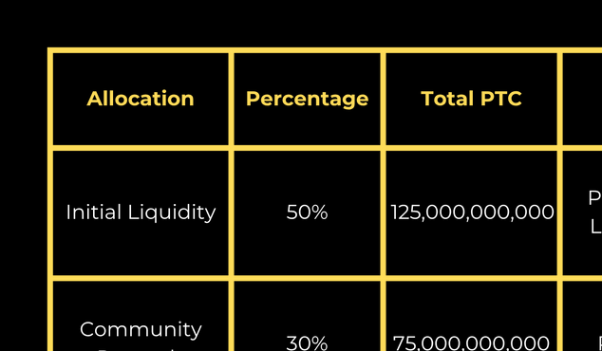
TOKENOMICS

Slide 6

ROADMAP
Phase 1 — Launch & Foundation
  Smart Contract Deployment on BSC
  PancakeSwap Listing with Liquidity Lock
  Website Launch & Social Media Activation
Initial Marketing & Community Campaigns
Phase 2 — Community Growth
  Contests, Airdrops & Engagement Events
  Partnerships with Key Community Figures
  CoinGecko & CoinMarketCap Listing Applications
Phase 3 — Expansion & Adoption
  Launch Staking & Holder Reward Options
  Governance Proposals for Community Decisions
  CEX Listing Applications & Partnerships

Slide 7

RISK DISCLAIMER
Poto Coin is a decentralized token with no inherent monetary value guarantee. The cryptocurrency market is volatile, and participants should conduct thorough due diligence before any involvement. The Poto Coin project is community-centered and does not constitute financial advice or investment solicitation.
CONTACT & COMMUNITY
Website
Twitter
Telegram
E-mail
Coming Soon

Slide 8

CONCLUSION
Poto Coin represents a new wave of community-driven assets on the Binance Smart Chain. With a clear vision, fair tokenomics, and an unwavering commitment to its holders, PTC invites everyone to join this transparent and decentralized journey

